Slide 1
Appointment No-Show Analysis in US Healthcare (RCM Focus)
(End-to-End Data Analysis using Excel, SQL Server & Power BI)
Mohd Shaan Saifi | Healthcare Analytics Case Study

Slide 2
Business Problem & Objective
Business Problem:
Appointment No-Shows lead to revenue leakage in healthcare
Missed appointments reduce provider utilization
Operational inefficiencies impact Revenue Cycle Management (RCM)
Project Objective
Identify key factors driving no-shows.
Analyze patient and operational drivers.
Provider actionable recommendations to reduce no-show rates.

Slide 3
DATA UNDERSTANDING & SCOPE
Dataset Overview
Healthcare appointment dataset (16K records)
Each row represents one scheduled appointment
Data includes patient, scheduling, and reminder attributes
Data Assumptions & Limitations
Dataset primarily contains weekday appointments
No rescheduling or cancellation history available
Key Fields Used
Appointment & scheduled dates
Waiting time (days between scheduling and appointment)
Patient demographics (age, gender)
SMS reminder status
Appointment outcome (showed-up / no-show)

Slide 4
TOOLS & ANALYTICAL APPROACH
Analytical Approach :-
Data cleaning and date validation in Excel
Waiting time calculation and logic validation
Exploratory analysis using pivot tables
Query-based validation and aggregation in SQL
Final Modeling and visualization in Power BI
Tools Used :-
Microsoft Excel
SQL Server (SSMS)
Power BI

Slide 5
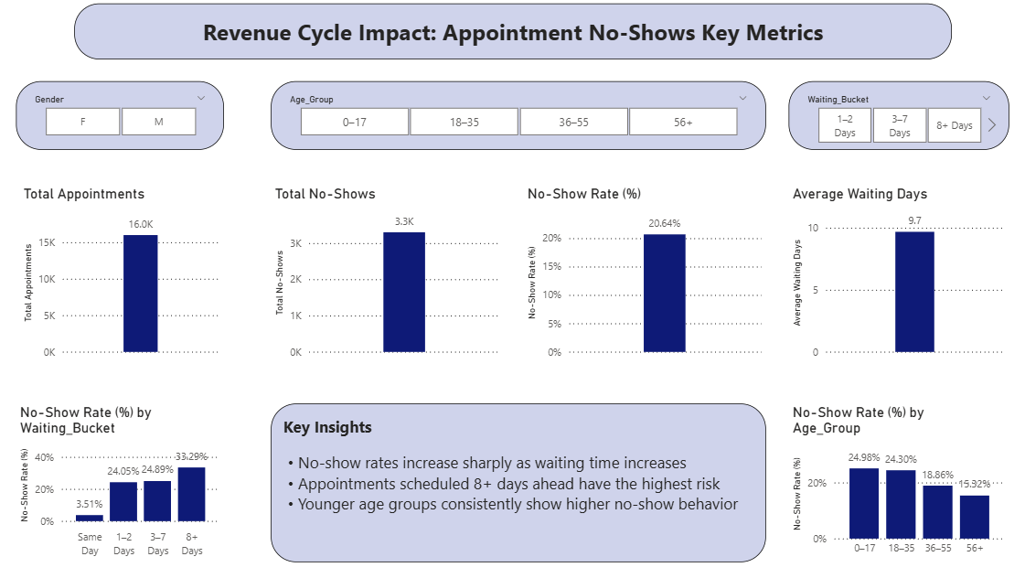
KEY INSIGHTS
 | • Overall no-show rate is 20%, indicating significant revenue leakage • No-show probability increases sharply as waiting time increases • Appointments scheduled 8+ days in advance represent the highest revenue risk segment and should be prioritized for intervention. • Younger age groups consistently demonstrate higher no-show behavior • Overall no-show rate is ~20%, impacting ~1 in 5 appointments

Slide 6
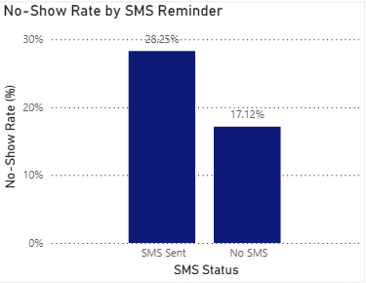
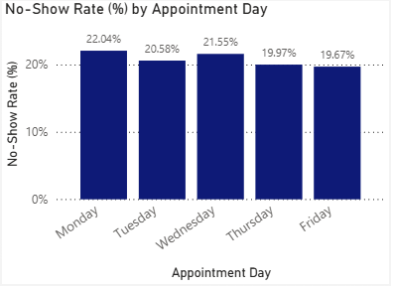
Operational Drivers of Appointment No-Shows
Key Operational Insights
Appointments that received SMS reminders show higher no-show rates, indicating reminders are targeted toward higher-risk patients rather than being ineffective
No-show rates vary moderately by appointment day, suggesting uneven operational or patient behavior patterns across weekdays
Weekday-only scheduling limits insight into weekend behavior, highlighting a data coverage limitation rather than an operational issue

Slide 7
Actionable Recommendations & Business Impact
Key Problems Identified
High no-show rates for appointments scheduled 8+ days in advance
Younger age groups show consistently higher no-show behavior
SMS reminders are primarily sent to high-risk patients, not broadly optimized
Moderate weekday variation suggests uneven operational load and engagement
Recommended Actions:-
Introduce shorter scheduling windows or controlled overbooking for long-wait appointments
Apply multi-touch reminders (SMS + call) for high-risk age groups
Optimize SMS reminder timing closer to appointment date
Allocate additional reminder or staffing efforts on higher-risk weekdays
Expected Business Impact:-
Reduction in no-show rates through improved patient engagement
Improved provider utilization and appointment slot efficiency
Lower revenue leakage caused by missed appointments
Better patient experience through proactive communication

Slide 8
Conclusion & Next Steps
Conclusion :-
Appointment no-shows represent a significant revenue leakage risk in US healthcare
Longer waiting times and specific patient segments are the primary drivers of no-shows
Data-driven operational interventions can reduce no-shows without significant additional cost
Next Steps :-
Analyze rescheduling and cancellation patterns if data becomes available
Incorporate appointment type, provider specialty, and visit time for deeper insights
Measure post-intervention impact to validate effectiveness of reminder strategies
This analysis demonstrates an end-to-end, business-focused approach to solving real-world revenue cycle challenges using data.

